Slide 1

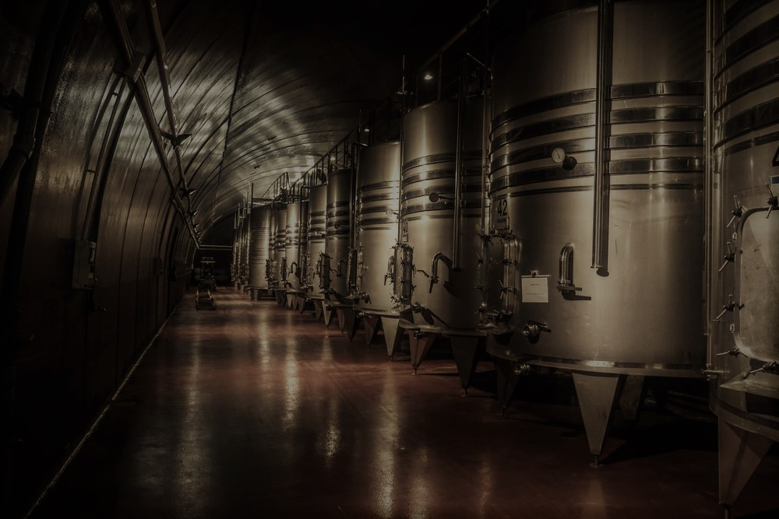
Beer Me
Find a brewery near you

Slide 2

Elevator Pitch
Whether you’re a local or a visitor, it’s good to know where your nearest brewery is. Beer Me provides a wealth of knowledge at your fingertips. Users can locate breweries near their location, as well as save their favorites to visit another day.

Slide 3
Technologies Used
React
Node JS
Express
Mongo DB
Semantic UI
Bootstrap

Slide 4
Breakdown of Roles
CORY & JASON:
Built Landing Page
Styled Using Semantic UI
Front-end focused
RAMON, FRANK, & JUAN:
Built back-end, connected database and API, set up login/sign up authentication.

Slide 5
Challenges
Learning the quirks of Semantic UI and getting it to render properly with React.
BACKEND CHALLENGE

Slide 6
Successes
Learning how to use Semantic UI
Coordinating as a team to complete our project on time
BACKEND SUCCESS

Slide 7
DEMO TIME!

Slide 8
Future Development
Set Up a payment portal to accept charitable donations.

Slide 9
Links
Github Repository: https://github.com/blueink38/beer-me
Deployed via Heroku @

